Slide 1
Oracle
How to see if an Invoice is Paid
How to Close a PO to Release Funds Back to Your Budget

Slide 2
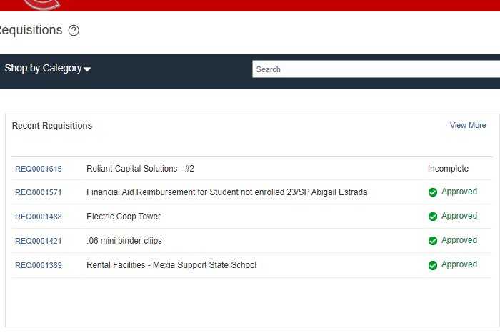
How to check if a payment has been made against your PO
Requisition Home page
Procurement – Purchase Requisitions – Click the Blue Hyperlink Requisition number you want to check for payment
You can use this steps to see
What you have received
Verify invoices sent to Accounts Payable
If payment has been processed
You must VALIDATE your payment has been made BEFORE you close a PO or your payment will not go thru.

Slide 3
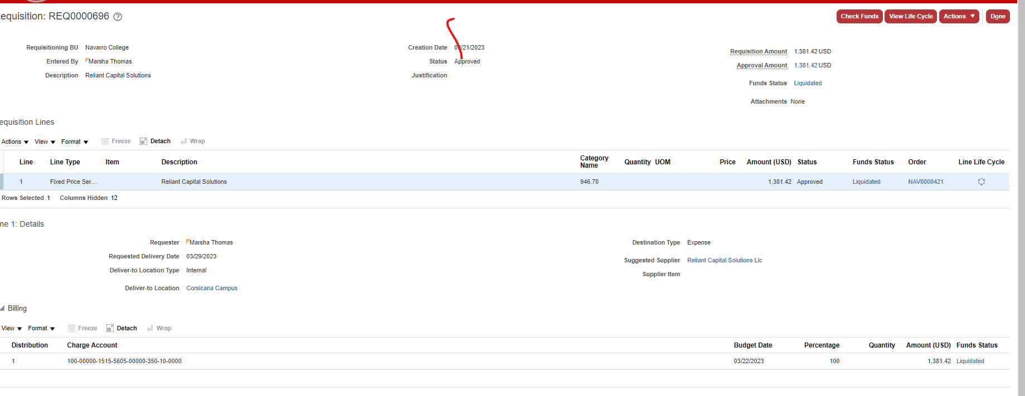
Click View Life Cycle
Info* Red button – Life Cycle shows information for the entire Requisition
Info* Line Life Cycle – shows only information on this single line

Slide 4
Receipts – This is what YOU have received
Fixed Price Service Requisition
w/multiple invoices received
Invoices – these are the invoices you have sent to Accounts Payable
Shows what is Paid or Pending Payment
Goods Requisition
received at one time

Slide 5
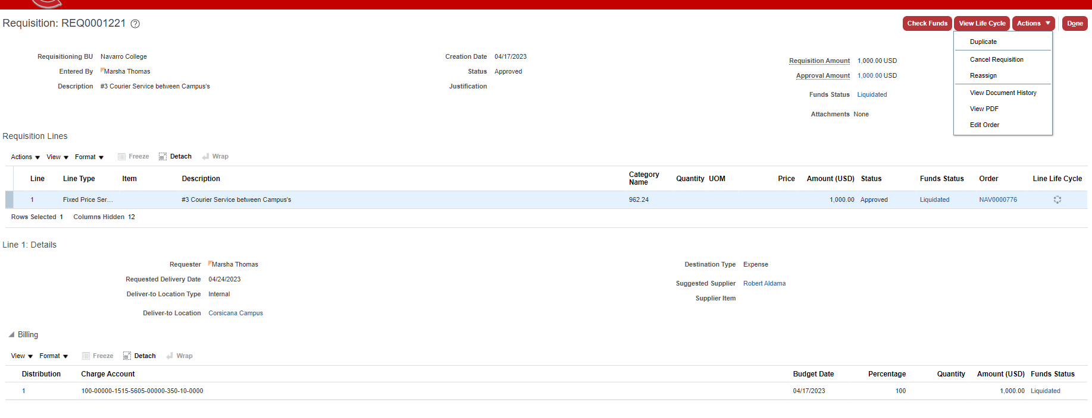
If All your invoices have been paid you can now close your Requisition / PO
Click Actions – Cancel Requisition
Requisition Home page
Procurement – Purchase Requisitions – Click the Blue Hyperlink Requisition number

Slide 6
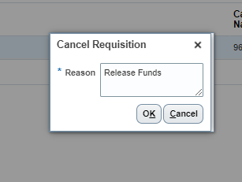
You will be responsible to close your REQ / PO’s at the end of each BUDGET Year.
Reason Pop up box -
Release Funds
(this is what your manager sees for approval)
Confirmation Pop Up Box – Shows you have successfully closed the Requisition / PO
Managers will receive a notification to approve – Funds will be released back to your budget

